Slide 1
Cell Wall Biosynthesis Inhibitors

Slide 2
SAR Learn Tool
SAR Requirements
Fosfomycin
1. PEP mimic
2. Reactive epoxide group
Cycloserine
1. D-Ala analogue
2. 5- membered ring
Fosfomycin
PEP
D-Alanine
Overlay
D-cycloserine

Slide 3
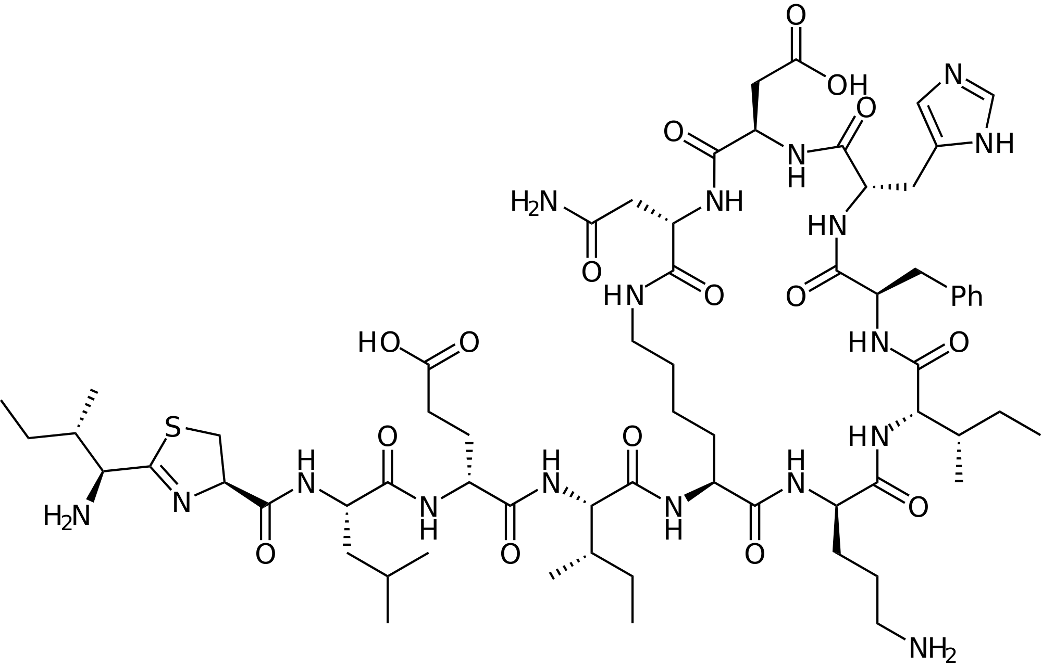
SAR Learn Tool
SAR Requirements
Bacitracin
Large molecule
Contains many peptide bonds

Slide 4
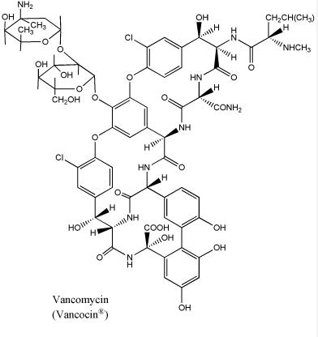
SAR Learn Tool
SAR Requirements
Vancomycin
Large molecule
Contains many peptide bonds
Circled atoms form hydrogen bonds with D-Ala-D-Ala

Slide 5
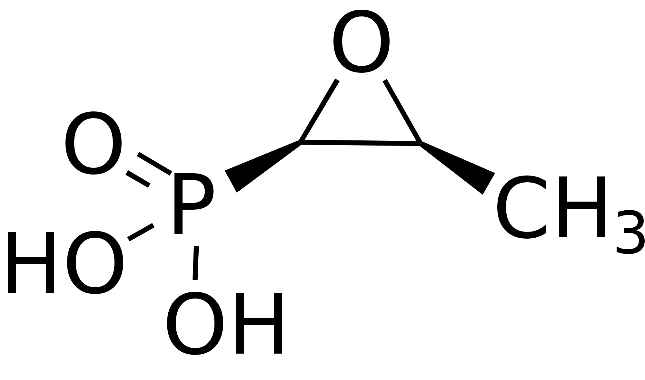
SAR Learn Tool
PRACTICE PROBLEM- Mechanism of Action
Which compound below interferes with peptide cross-linking?
ANSWER: Compound 3 (Vancomycin)
Binds directly to the D-Ala-D-Ala terminal to prevent peptide cross-linking

Slide 6
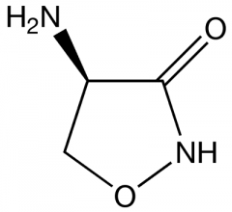
SAR Learn Tool
PRACTICE PROBLEM- Mechanism of Action
Which compound below inhibits the conversion of UDP-NAG→ UDP-NAM?
ANSWER: Compound 2 (fosfomycin)
Results in irreversible alkylation of the active cysteine on MurA

Slide 7
SAR Learn Tool
PRACTICE PROBLEM- Mechanism of Action
Which compound below inhibits Ala racemase & D-Ala ligase?
ANSWER: Compound 3 (cycloserine)
Prevents conversion of L-Ala→ D-Ala and the joining of D-Ala & D-Ala

Slide 8
SAR Learn Tool
PRACTICE PROBLEM- Mechanism of Action
Which compound below inhibits pyrophosphatase?
ANSWER: Compound 1 (bacitracin)
Inhibits the recycling of bactoprene molecule

Slide 9
SAR Learn Tool
PRACTICE PROBLEM: SAR Clinical Case Study
GT is diagnosed with C. difficile. Which oral antibiotic would be best to treat his infection?
ANSWER: Compound 3 (Vancomycin)
Vancomycin is not orally absorbed, so it will stay in the gut to treat the infection in the large intestine

Slide 10
SAR Learn Tool
PRACTICE PROBLEM: SAR Clinical Case Study
SM is diagnosed with a UTI infection. Which compound would be best to treat his infection and has few side effects?
ANSWER: Compound 2 (Fosfomycin)
Fosfomycin is indicated for urinary tract infections, and is especially active against E. Coli

Slide 11
SAR Learn Tool
PRACTICE PROBLEM: SAR Clinical Case Study
GT has a history of psychosis. Which antibiotic below is best avoided in this patient?
ANSWER: Compound 1 (Cycloserine)
Cycloserine acts as a partial agonist at the NMDA receptor can result in dose-dependent neurologic and psychiatric disturbances.

Slide 12
SAR Learn Tool
PRACTICE PROBLEM: SAR Clinical Case Study
BK has kidney dysfunction. Which 2 antibiotics below have side effects that would be harmful to this patient?
ANSWER: Compound 1 & Compound 2
Bacitracin and vancomycin can both result in nephrotoxicity

Slide 13
SAR Learn Tool
PRACTICE PROBLEM: SAR Clinical Case Study
AM’s bacterial infection is not responding to treatment. The bacteria in her body have become resistant to the antibiotic by producing D-Ala-D-Lac. Which of the antibiotics was she taking?
ANSWER: Compound 3 (vancomycin)
Vancomycin normally binds to D-Ala-D-Ala of the pentapeptide tail, but with this change to D-Ala-D-Lac, it can no longer bind

